Slide 1
CS2310 Computer Programming
LT8: Characters and Strings
Computer Science, City University of Hong Kong
Semester B 2021-22

Slide 2
Outline
Characters
Declaration and Initialization
ASCII
Input and Output (cin,cout)
Strings
Declaration and Initialization
Copy and compare
Input and output

Slide 3
Character data type
Written between single quotes. Examples
'A', 'b', '*'
In C++ language, a char type is represented by an integer
Therefore, a character can also be treated as an integer

Slide 4
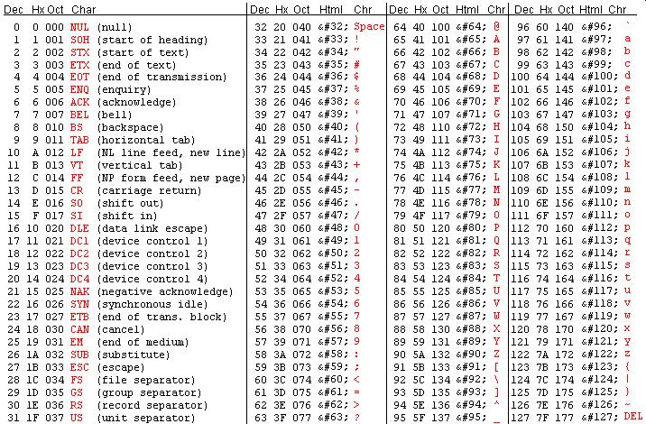
ASCII Table
cout << (int) ‘7’;
cout << (char) 97;

Slide 5
char features
A | B | ... | Z | ... | a | b | ... | z
65 | 66 | ... | 90 | .. | 97 | 98 | ... | 122
'a' + 1 has the value of 'b',
'b' + 1 has the value of 'c', ...
test if character ch is a lower-case letter:
if ('a' <= ch && ch <= 'z') ...
same as:
if (97 <= ch && ch <= 122) ...
If the variable ch is a lowercase letter, then the expression
ch – ‘a’ + 'A' /*same as ch -97 + 65*/
has the value of the corresponding uppercase letter

Slide 6
Example
#include<iostream>
using namespace std;
void main(){
char c1='D', c2='e', c3,c4;
c3=c1-'A'+'a'; //convert to lowercase
c4=c2-'a'+'A'; //convert to uppercase
cout<< “c3=“ << c3 << “, c4=“ << c4 << endl; //c3=d, c4=E
}

Slide 7
Reading a character
char c1,c2;
cin >> c1;
When cin >> c1 is reached, the program will ask the user for input.
Suppose the character 'A' is input, c1 will evaluate to 65 (which is the ASCII code of 'A').
As a result, 65 will be assigned to the character c1. Therefore, c1 holds the character 'A'

Slide 8
Some facts about keyboard Input
Suppose >> is called to read a character.
What if the user input more than 1 characters in a single line?
Answer: The extra character will be stored in a buffer (certain memory location). The character will be retrieved later when >> is called to read more characters

Slide 9
Some facts about keyboard Input
char c1,c2,c3;
cin >> c1; //enter the string "CS2310"
cin >> c2; //get the character 'S' from buffer
cin >> c3; //get the character '2' from buffer
 | c1 | c2 | c3 | Input buffer
(user input “ cs2310”)
cin >> c1; | ‘C’
cin >> c2; | ‘C’ | ‘S’
cin >> c3; | ‘C’ | ‘S’ | ‘2’
C
S
2
3
1
0
S
2
3
1
0
2
3
1
0
3
1
0

Slide 10
Printing a character
char c1='A',c2='B';
cout << c1;
cout.put(c1);

Slide 11
Example
Write a program which reads a character from the user and output the character type
The program should distinguish between the following types of characters
An upper case character ('A'-'Z')
A lower case character ('a'-'z')
A digit ('0'-'9')
Special character (e.g. '#', '$', etc.)

Slide 12
Answer
#include<iostream>
using namespace std;
void main(){
char c;
cin >> c;
if ( )//'A'-'Z'
cout << "An upper case character\n";
else if ( )//‘a'-‘z'
cout << "A lower case character\n";
else if ( )//‘0'-‘9'
cout << "A digit\n";
else
cout << "Special character\n";
}

Slide 13
Answer
#include<iostream>
using namespace std;
void main(){
char c;
cin >> c;
if ('A' <=c && c<='Z') //'A'-'Z'
cout << "An upper case character\n";
else if ('a' <= c && c<='z') //‘a'-‘z'
cout << "A lower case character\n";
else if ('0' <= c && c<='9') //‘0'-‘9'
cout << "A digit\n";
else
cout << "Special character\n";
}

Slide 14
Strings

Slide 15
cstring vs string object
In C++, there are two types of strings
cstring: inherited from the C language
string: class defined in <string> library

Slide 16
String : cstring
A cstring is a char array terminated by'\0' (which is named null character) representing the end-of-string sentinel.
A character of array of size n may store a string with maximum length of n-1
Consider the definition
char str[20]="Hello World";
H
e
l
l
o
W
o
r
l
d
\0
This character array may store a string with maximum length of 19

Slide 17
Rule of Safety
Declare a string with one more character than needed
E.g.
char studentID[8+1]; //51234567
char HKID[10+1]; //a123456(7)

Slide 18
cstring: Declaration and Initialization
String variable can be declared in one of two ways
Without initialization
char identifier[required size+1]
E.g.
char name[12]; // name with 11 characters
char Address[50]; // Address with 49 characters
With initialization
char identifier[]=string constant
E.g.
char name[]=“John”; //name with 5 characters
char choice[]=“a,b,c,d,e”; //choice with 10 characters
However, you cannot initialize a string after declaration
char name[10];
name=“john”;
error C2440: '=' : cannot convert from 'const char [5]' to 'char [10]'

Slide 19
Example
void main
{
int mark;
char grade;
cin>>mark;
if(mark>80)
grade='A'; //grade=”A”;
else if(mark>60)
grade='B';
else if(mark>50)
grade='C';
else
grade='F';
cout<<grade<<endl;
}
error C2440: '=' : cannot convert from 'const char [2]' to 'char'

Slide 20
cstring : Reading and Printing
#include<iostream>
using namespace std;
void main(){
char word[20];
cin >> word; //read a string
cout << word; //print a string
}
The array word can store 20 characters but we can only we up to 19 character (the last character is reserved for null character).

Slide 21
Reading a line of characters
cin >> str will terminate when whitespace characters (space, tab, linefeed, carriage-return, formfeed, vertical-tab and newline characters) is encountered
Suppose "hello world" is input
char s1[20],s2[10];
cin >> s1; //user input "hello world"
cin >> s2; //does not require user input
cout << s1; //output "hello"
cout << s2; // output "world"
How to read a line of characters (before ‘\n’ is encountered)?

Slide 22
cin.get
get(): member function of cin to read in one character from input
Syntax:
char c;
cin.get(c);

Slide 23
1. cin.get + while loop
#include <iostream>
using namespace std;
void main(){
char c;
do {
cin.get(c);
cout << c;
}while (c!='\n');// before ‘\n’ is encountered
}

Slide 24
2. cin.getline
Predefined member function of cin to read a line of text (including space)
Two arguments:
cstring variable to receive the input
size of the cstring
#include <iostream>
using namespace std;
void main(){
char s[20];
while (1){
cin.getline(s,20);
cout << “\”” << s << “\”” << endl;
}
}

Slide 25
cin.getline
What if
Input is longer than the string variable?
End of the source characters is reached?
Error occurred?
Internal state flags (eofbit,failbit,badbit) of cin object will be set
To reset those flags, call method clear() of cin. E.g. cin.clear();

Slide 26
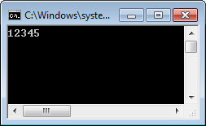
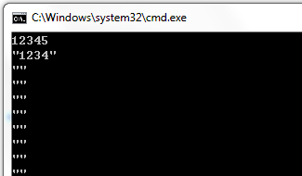
Example
#include <iostream>
using namespace std;
void main(){
char s[5];
while (1){
cin.getline(s,5);
cout << “\”” << s << “\”” << endl;
}
}

Slide 27
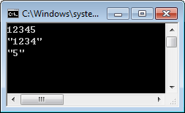
Example
#include <iostream>
using namespace std;
void main(){
char s[5];
while (1){
cin.getline(s,5);
cin.clear();
cout << “\”” << s << “\”” << endl;
}
}

Slide 28
The Null Character ‘\0’
The null character,’\0’, is used to mark the end of a cstring
‘\0’ is a single character (although written in two symbols => escape sequence)
It is used to distinguish a cstring variable from an ordinary array of characters (cstring variable must contain the null character)

Slide 29
Why need ‘\0’?
cstring is stored in main memory continuously
Only the starting address of the cstring is stored in cstring variable
char s1[]=“Hello World”; // s1=20
char s2[]=“cs2310”; // s2=32
‘\0’ indicates the end of cstring
 | 0 | 1 | 2 | 3 | 4 | 5 | 6 | 7 | 8 | 9
0 | r | o | g | r | a | m | m | i | n | a
1 | O | - | m | a | 4 | 1 | . | ; | t | a
2 | H | e | l | l | o |  | w | o | r | l
3 | d | \0 | c | s | 2 | 3 | 1 | 0 | \0 | &
4 | 1 | * | ~ | ^ | b | / | a | v | e

Slide 30
Why need ‘\0’?
When a cstring variable is passed to a output function, i.e. cout, the function will print all the memory content until ‘\0’ is encountered
 | 0 | 1 | 2 | 3 | 4 | 5 | 6 | 7 | 8 | 9
0 | r | o | g | r | a | m | m | i | n | a
1 | O | - | m | a | 4 | 1 | . | ; | t | a
2 | H | e | l | l | o |  | w | o | r | l
3 | d | \0 | c | s | 2 | 3 | 1 | 0 | \0 | &
4 | 1 | * | ~ | ^ | b | / | a | v | e

Slide 31
Why need ‘\0’?
#include <iostream>
using namespace std;
void main(){
char s1[]="cs2310";
char s2[]="Hello world";
s2[11]=' ';//change ‘\0’ to a space character ‘ ‘;
cout << s2;
cout << endl;
}

Slide 32
Passing strings to functions
Example:
Write a function to count the frequency of a character (e.g., ‘a’) in a string
Functions
count: given a character and a string as input, return the frequency of the character in the string
main function: call count function

Slide 33
Function : count
The size 100 is optional
int count(char s[100], char c){
int frequency=0;
int i=0;
while (s[i]!='\0')
{
if (s[i]==c)
frequency++;
i++;
}
return frequency;
}

Slide 34
Function : count
The size 100 is optional
int count(char s[100], char c){
int frequency=0;
int i=0;
while (s[i]!='\0')
{
if (s[i]==c)
frequency++;
i++;
}
return frequency;
}

Slide 35
The main function
void main(){
char str[50]=”CityU is a very good university";
int freq = count(str, 'a');
cout << " freq = “ << freq << “ \n");
}
int count(char s[100], char c)
{
…
}

Slide 36
Common cstring functions in <cstring>
Function | Description | Remarks
strcpy (dest, src) | Copy the content of string src to the string dest | No error check on the size of dest is enough for holding src
strcat (dest, src) | Append the content of string src onto the end of string dest | No error check on the size of dest is enough for holding src
strcmp(s1, s2) | Lexicographically compare two strings, s1 and s2, character by character. | 0: s1 and s2 is identical >0: s1 is greater than s2 <0: s1 is less than s1
strlen(str) | Returns the number of characters (exclude the null character) contain in string str
Note: you may need to use strcpy_s and strcat_s instead of strcpy and strcat if you are using the latest visual studio.

Slide 37
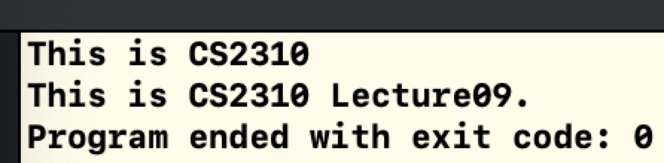
strcpy (dest, src), strcat (dest, src)
#include<iostream>
using namespace std;
int main() {
char src[] = "This is CS2310";
char dest[40];
strcpy(dest, src);
cout << dest << endl;
strcat(dest, " Lecture09.");
cout << dest << endl;
return 0;
}

Slide 38
Try to implement: copy
Suppose there are two strings, str1 and str2
str1 is initialized to "Hello world"
Copy str1 to str2
We should NOT use the following expression to copy array elements
str2=str1;
Similarly, we should NOT use the following expression to compare strings
if (str1==str2) ......

Slide 39
Idea
Use a loop to read characters one by one from str1 until a null character ('\0') is read
Copy the character to the corresponding position of str2
Put a null character at the end of str2

Slide 40
The program
#include<iostream>
using namespace std;
void main(){
char str1[20]="Hello world";
char str2[16];
int i;
/*beware of the boundary condition!*/
for (i=0; i<15 && str1[i]!='\0'; i++) {
str2[i]=str1[i];
}
str2[i]='\0';
cout << str2;
}

Slide 41
Try to implement: append content
#include<iostream>
using namespace std;
void main(){
char s1[20]="Welcome to ";
char s2[20]="CS2310";
long s1_length = strlen(s1);
long s2_length = strlen(s2);
char s[100];
long i = 0;
for (; i<s1_length; i++)
s[i] = s1[i];
for (; i<s1_length+s2_length; i++)
s[i] = s2[i-s1_length];
cout << s << endl;
}

Slide 42
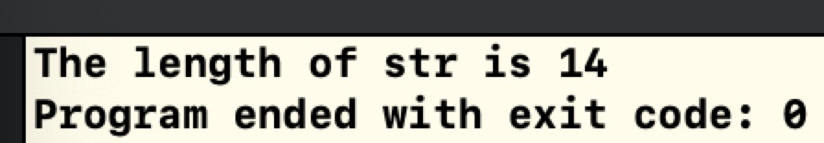
strlen(str)
#include<iostream>
using namespace std;
int main() {
char str[50];
long len;
strcpy(str, "This is CS2310");
len = strlen(str);
cout << “The length of str is ” << len << endl;
}

Slide 43
Try to implement: string length
#include<iostream>
using namespace std;
int length_of_string (char s[]){
int length = 0;
while (s[length]!=‘\0’)
length++;
return length;
}
void main(){
char s[20]="Hello world";
cout << length_of_string(s);
}

Slide 44
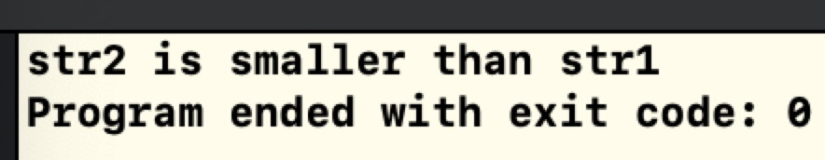
strcmp(s1, s2)
#include<iostream>
using namespace std;
int main() {
char str1[15];
char str2[15];
int ret;
strcpy(str1, "abcdef");
strcpy(str2, "ABCDEF");
ret = strcmp(str1, str2);
if(ret < 0)
cout << "str1 is smaller than str2" << endl;
else if(ret > 0)
cout << "str2 is smaller than str1" << endl;
else
cout << "str1 is equal with str2" << endl;
}

Slide 45
Try to implement: Compare two strings with the same length
#include<iostream>
using namespace std;
int main(){
char s1[15] = "abcdef";
char s2[15] = "abcdEF";
long size = strlen(s1);
for (int i = 0; i < size; i++) {
if (s1[i] < s2[i]) {
cout << "str1 is smaller than str2" << endl;
return -1;
} else if (s1[i] > s2[i]) {
cout << "str2 is smaller than str1" << endl;
return 1;
}
}
cout << "str1 is equal with str2" << endl;
return 0;
}

Slide 46
Example
Write a program to print a word backward.
Example:
Input:
hello
Output:
olleh

Slide 47
The program
#include<iostream>
using namespace std;
void main(){
char ____; //define an array input with size 20
int n; //length of str
int i;
cin >>____;
n=______; //compute string length
for (i=____; i > 0 ;i--)
cout <<____ ;
}

Slide 48
Exercise
Write a program to let the user to input a line of string from the user
The program should reverse the case of the input characters and print the result
Lowercase characters are changed to uppercase
Uppercase characters are changed to lowercase
Example input/output:
Hello World
hELLO wORLD

Slide 49
Program
#include<iostream>
using namespace std;
void main(){
char s[20];
int i;
cin.getline(s);
for (i=0; s[i]!='\0'; i++){
if ( ) //uppercase letter
cout << ; //convert to lowercase
else if (s[i]>='a' && s[i]<='z') //lowercase letter
cout << ; //convert to uppercase
else //other characters
cout << ;
}
}

Slide 50
Answer
#include<iostream>
using namespace std;
void main(){
char s[20];
int i;
cin.getline(s);
for (i=0; s[i]!='\0'; i++){
if (s[i]>='A' && s[i]<='Z') //uppercase letter
cout << s[i]+'a'-'A'; //convert to lowercase
else if (s[i]>='a' && s[i]<='z') //lowercase letter
cout << s[i]+'A'-'a'; //convert to uppercase
else //other characters
cout << s[i] ;
}
}

